Slide 1
Medical Platform
St Paul Dubai servants

Slide 2
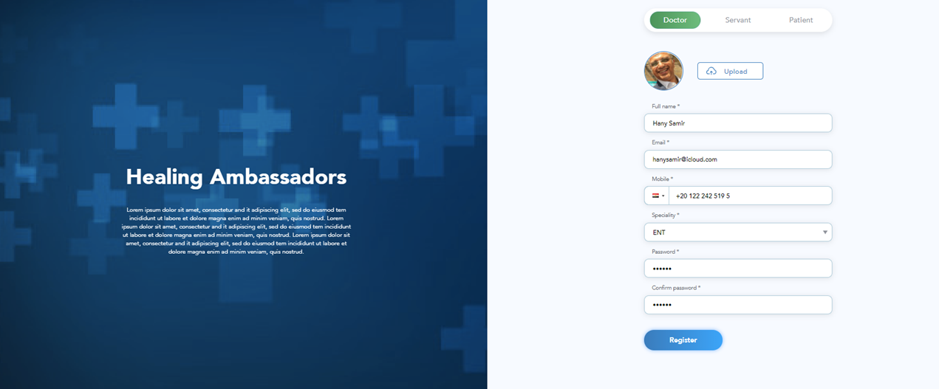
Doctors’ registration
Please access “Healing Ambassadors” platform on https://stage.healingambassadors.net
Click on “Register”
Enter your full name, e-mail address, your mobile number, your speciality, your password and confirm your password.
Upload your photo then click on “Register”

Slide 3
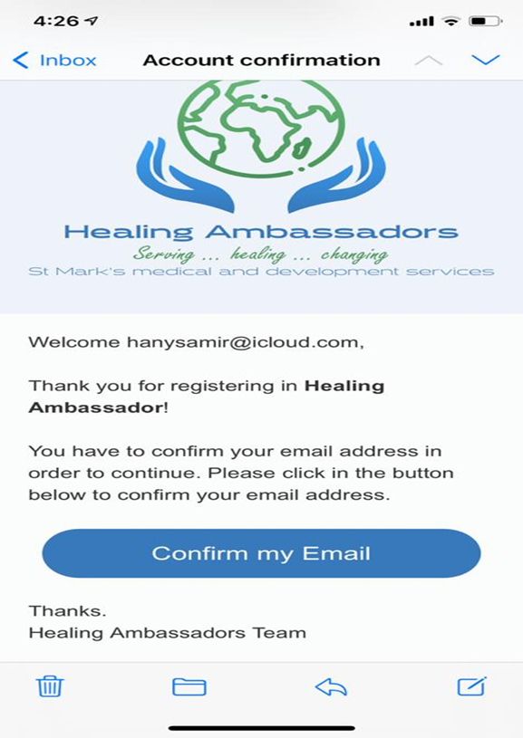
Doctors registration
You will receive a confirmation e-mail, so please check
your inbox and click on “Confirm my E-mail”
To ensure the high security of the Doctor’s data,
an “Admin” will get a notification that you have registered
and approve your access

Slide 4
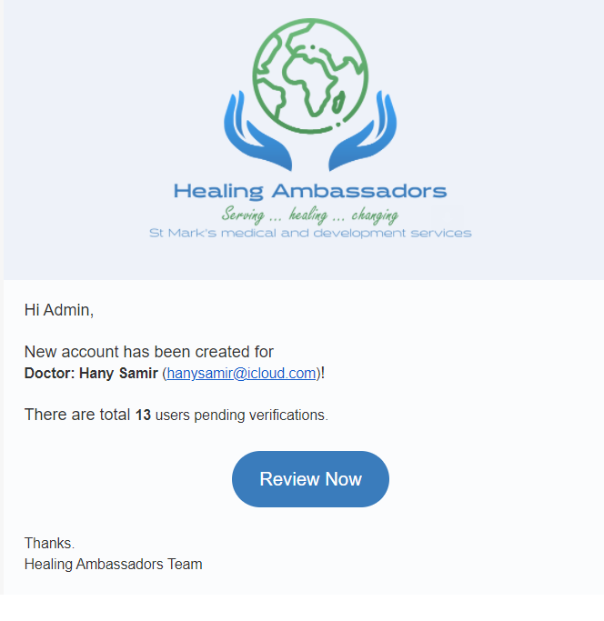
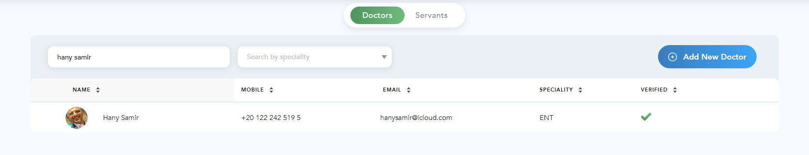
Doctors registration
To ensure the high security of Doctor’s data,
an “Admin” will get a notification that you have
registered and approve your access
Doctors will not be able to access the platform
until “Admin” approves your access

Slide 5
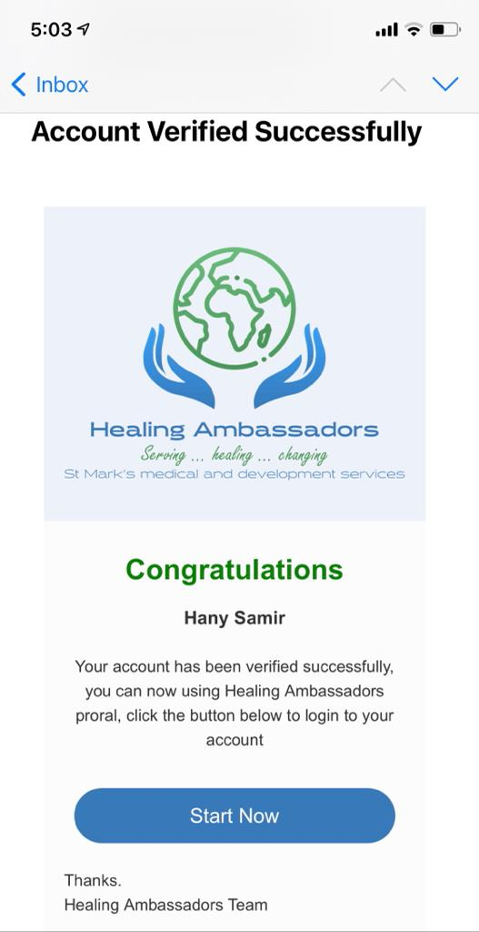
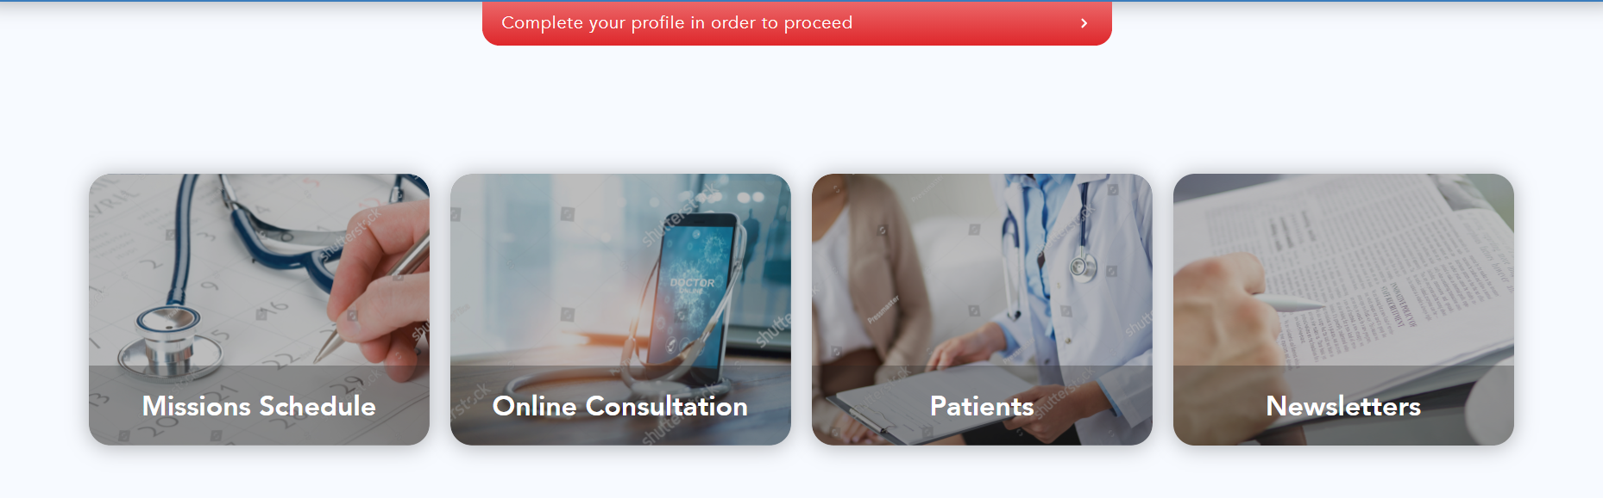
Doctors registration
You will receive an “Account Verification” e-mail, so please
Check your inbox and click on “Start Now”
You will be directed to “Healing Ambassadors” home page.
Log-in using your username and password which you created.
You will be asked to “Complete your profile”

Slide 6
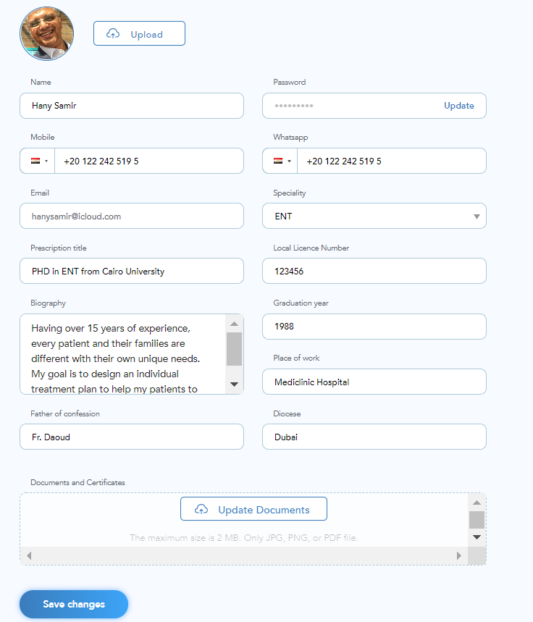
Doctors registration
“Prescription info”: Fill in your data that you wish to include in the prescription format.
“Local License Number”: If you have a local license number in the destination you will serve
“Biography”: a brief about your experience
“Documents and Certificates”: Upload your scanned certificates and local license (if you have it)
“Save the changes”: and you will be done.
It’s easy to update your profile at any point

Slide 7
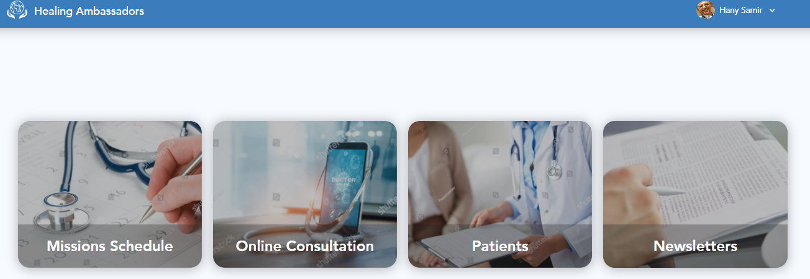
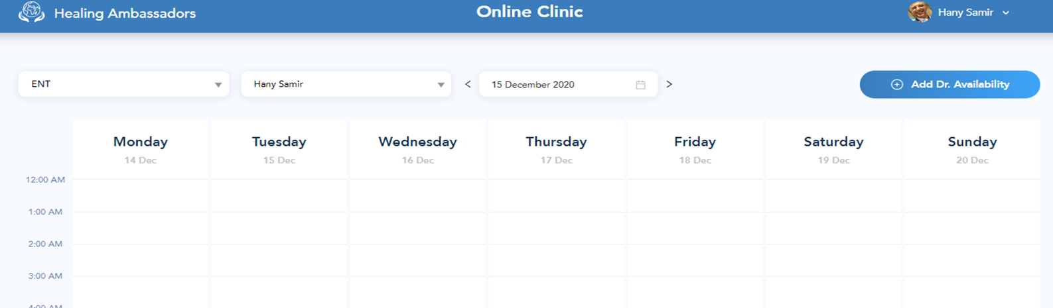
Adding Doctors’ Availability
Click on “Healing Ambassadors” to get to the home page.
Click on “Online Consultation” and you will be directed to the “Schedule page”
Select your specialty, your name and click on “Add Dr. Availability”

Slide 8
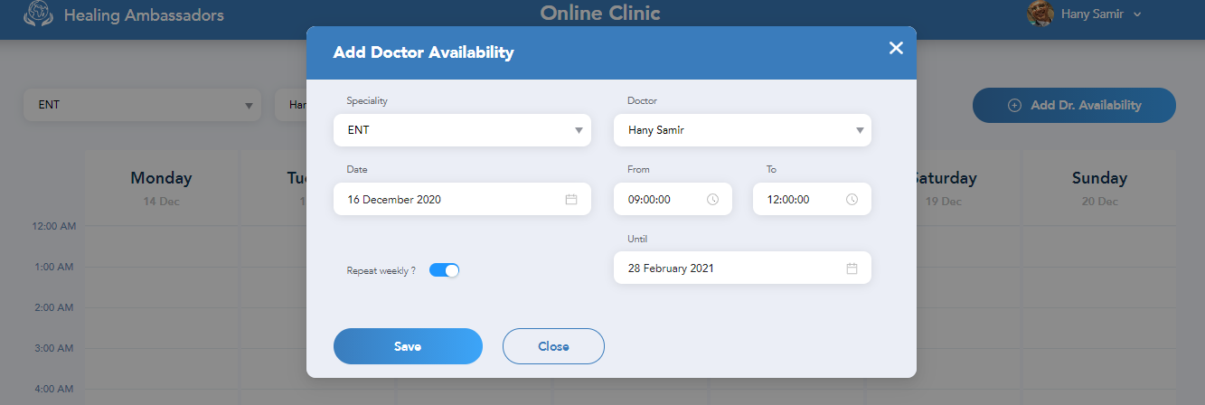
Adding Doctors’ Availability
Select your specialty and your name.
“Date”: choose the day of the week you will allocate for “St Paul online clinic” (Ex: Wednesday 16 Dec)
“Time”: The hours “From - To” you will allocate on that day based on your country local time (Ex: From 09:00 am to 12:00 pm Cairo time). Time will reflect in the local time of the country you wish to serve (Ex: from 15:00 pm to 18:00 pm Manila time)
“Repeat weekly”: If you wish to repeat the same “day and time” weekly
Below example: Doctor will be available every Wednesday, between 09:00 am to 12:00 pm Cairo local time, starting from 16th December 2020 until the 28th February 2021.
Click on “Save” to publish your schedule to all destinations

Slide 9
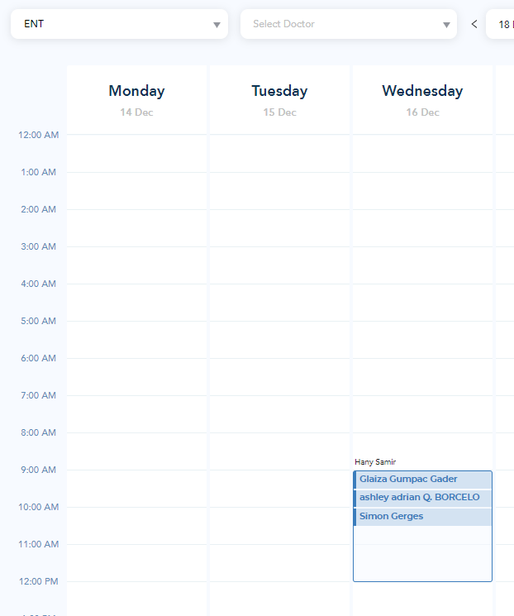
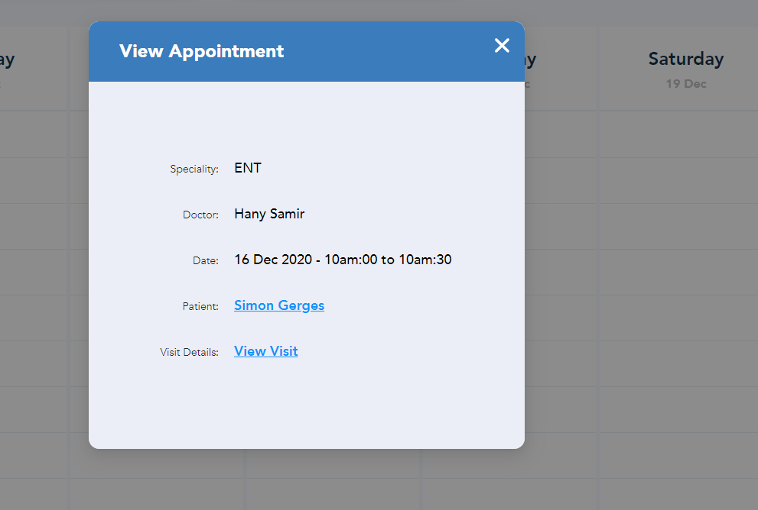
Doctor’s appointments
After you login and click on “Online Consultation” and select your “specialty”, you can see your weekly pre-booked appointments.
Calendar will show your appointments for this week. You can move the calendar to the left or right to see previous or following weeks
Click on the “patient’s name” inside your calendar, you will get “view appointment”

Slide 10
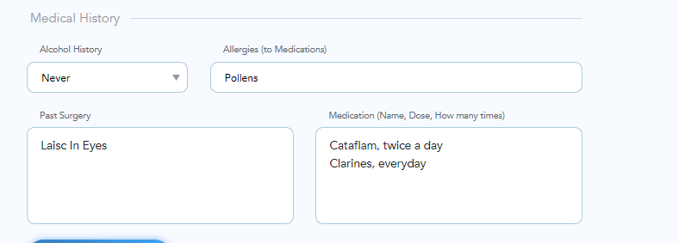
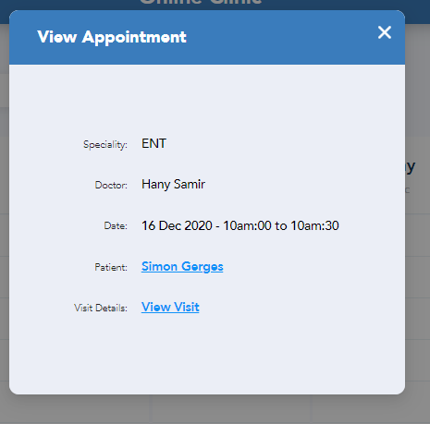
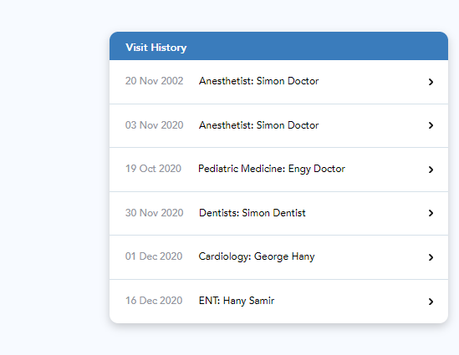
Doctor’s appointments
Click on:
“Patient’s name”
Also, you can see “Visits History” (previous consultations) with same and other specialties
By clicking on any of the “previous consultations”, Doctor can see the old diagnosis as well as old Prescriptions to the same patient.
Doctor can see the “medical history”

Slide 11
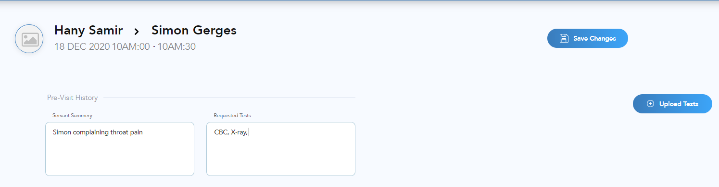
Doctor’s appointments
Click on:
“View Visit”
Doctor will use this screen:
Prior to the online consultation’s day to
“request tests” and “save changes”.
Servant will receive notification with the requested tests for the patient
Servant will communicate with patient to proceed with requested tests
Servant will upload tests in the “view appointment” screen to be ready during online consultation

Slide 12
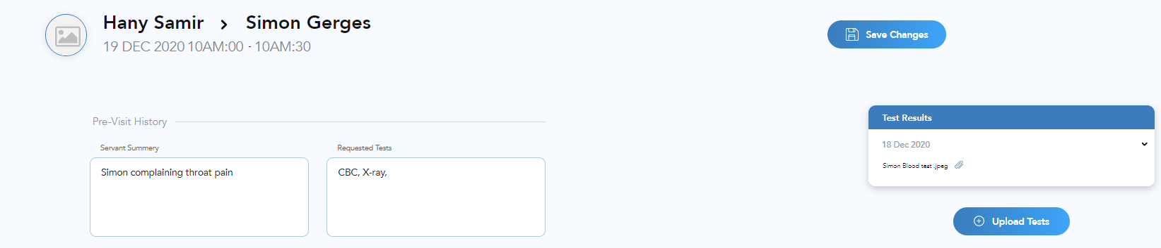
During Doctor’s Online Consultation
During “Online Consultation” doctors will
Click on: “View Visit”
Doctor will click on “test results”
Doctors will view patient’s tests results by clicking on the attached document
Test results will appear as PDF format

Slide 13
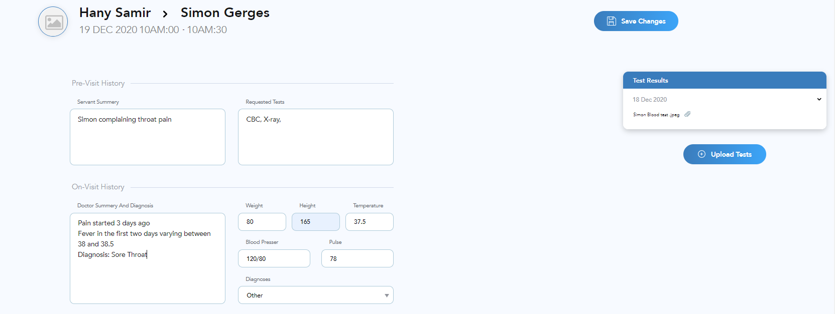
During Doctor’s Online Consultation
Doctor will move down in the screen of the “Visit Details”
Doctor will type the symptoms summary and diagnosis under “Doctor summary and diagnosis”
Doctors will ask the servant to fill the requested data such as: weight, Height, temperature, blood pressure and pulse
“Diagnosis” should be in a drop-down list based on each specialty

Slide 14
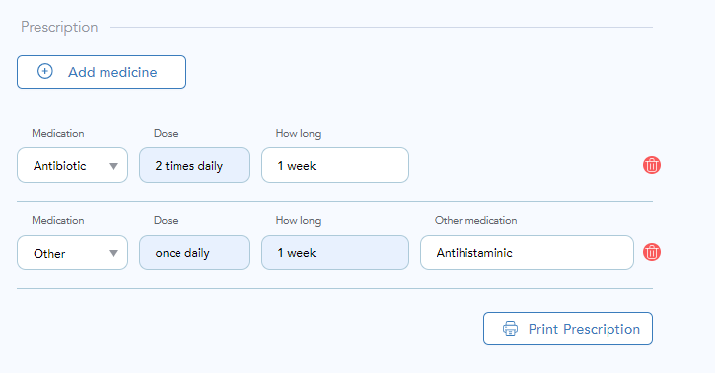
During Online Consultation
Doctor will move down in the screen of the “Visit Details”
To write the prescription for the patient, Doctor will click on “Add Medicine”
Doctors will choose from the drop-down list if the requested medicine is available, then insert the dose and the duration
Doctors will choose “other” if medicine is not available in the dropdown list, and put the scientific name under “other medication”, as well as the dose and the duration
Doctor will save the medicines to allow the local servant to “print prescription”

Slide 15
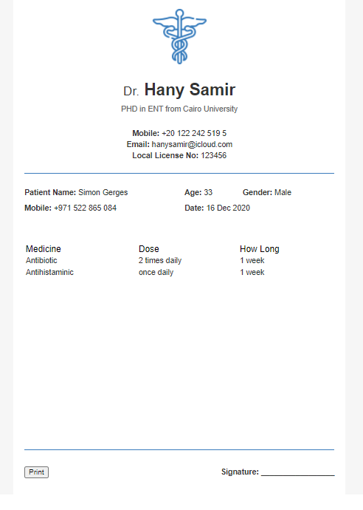
Patient’s prescription
The prescription will include:
Doctor’s data as per doctor’ profile
Patient data
Medicines, dose and duration
Doctor’s signature
Servant can print the prescription and hand it over to the patient

